Slide 1
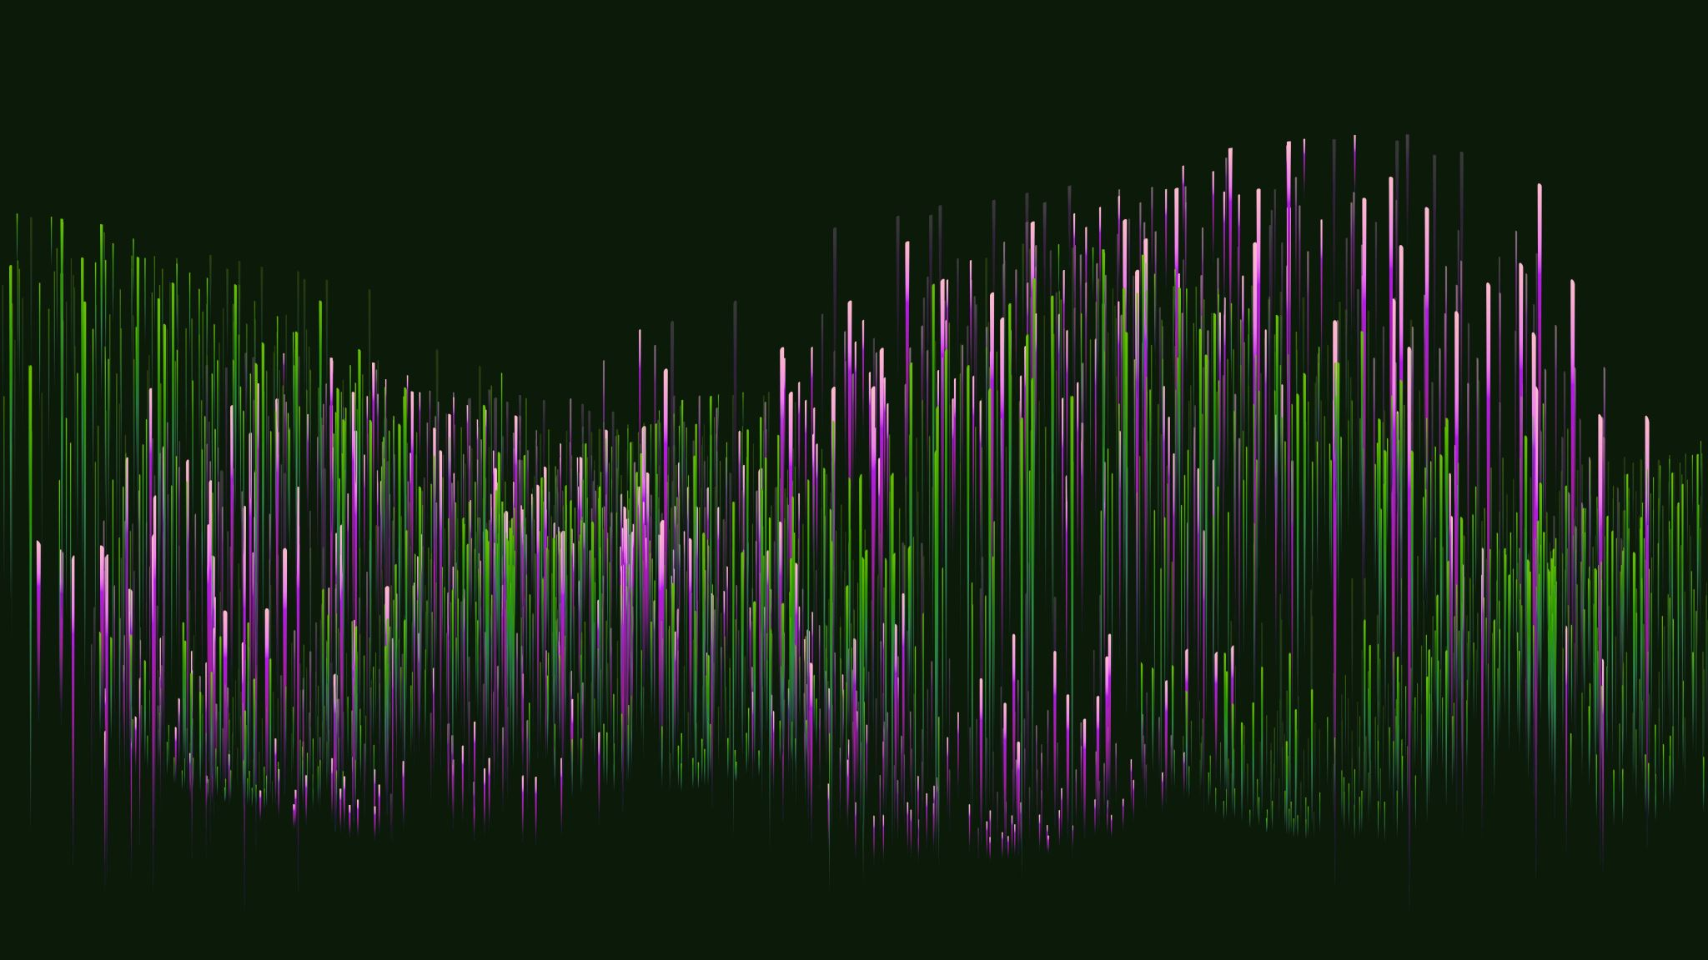
Assessing blood samples for malaria
PDO
Tomáš Ťažár

Slide 2
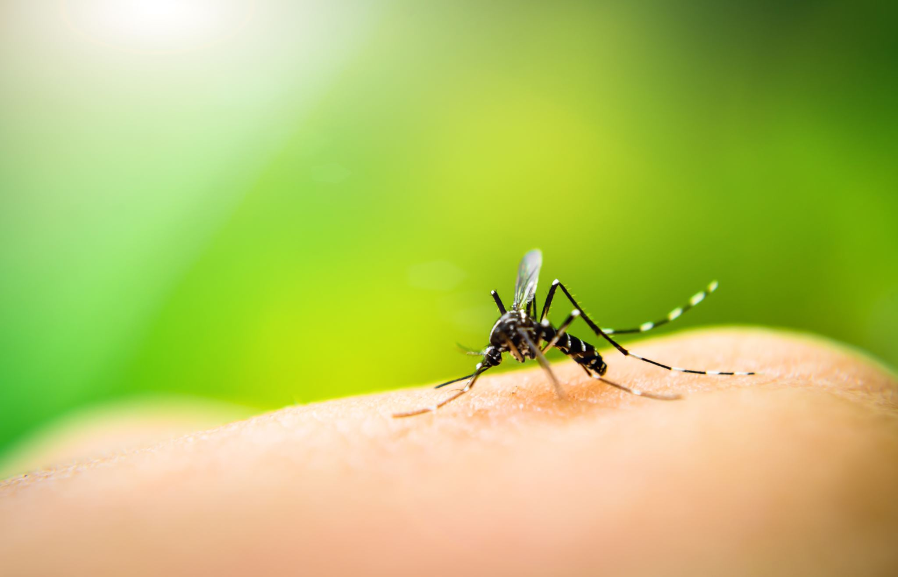
Problem statement
Malaria is a life-threatening disease, that has plagued humanity for thousands of years.
In the 21st century, the incidence of malaria remains high with an estimated 247 million cases of malaria in 2021 accompanied by a death toll of 619 000.
It is speculated that entire populations, especially in sub-Saharan Africa, are infected more or less constantly.
The most time-consuming part of malaria is its diagnosis, this poses a massive issue as manual segmentation of patient blood smears and red blood cell classification is required to be done by specialised personnel which is rarely available, especially in endemic areas.
Resource strain is exacerbated with the need for specialised personnel to be available in multiple endemic areas.
This creates life-threatening consequences if not addressed.

Slide 3
Main project objectives
Develop an automatic segmentation methodology
Develop an automatic classification methodology
Create an end-to-end solution that is:
Easy-to-operate
Non-resource-intensive
Accessible
Low-cost/Open-source
The end-to-end solution must possess high accuracy & reliability
These factors are extremely important as they allow us to effectively, easily and rapidly identify & diagnose malaria and apply necessary prevention methods

Slide 4
Our solution to combat Malaria
We developed an end-to-end software solution to diagnose malaria patients utilizing the power of machine learning-based classification and computer vision-based segmentation.
This solution can efficiently, accurately, and reliably classify malaria-ridden blood cells in blood smear images.
We provide a solution for the need for tedious diagnosis by medical specialists in endemic areas thereby decreasing resource demand, and resource sparsity. This also decreases the risk of disease spread in endemic areas.
With the use of our innovative software solution approach, we gather invaluable information and data from affected regions and forward it to external operating experts for final validation if necessary.
This information is for continuous and systematic collection, analysation and interpretation of malaria-related data which is then used to aid the fight against malaria.

Slide 5
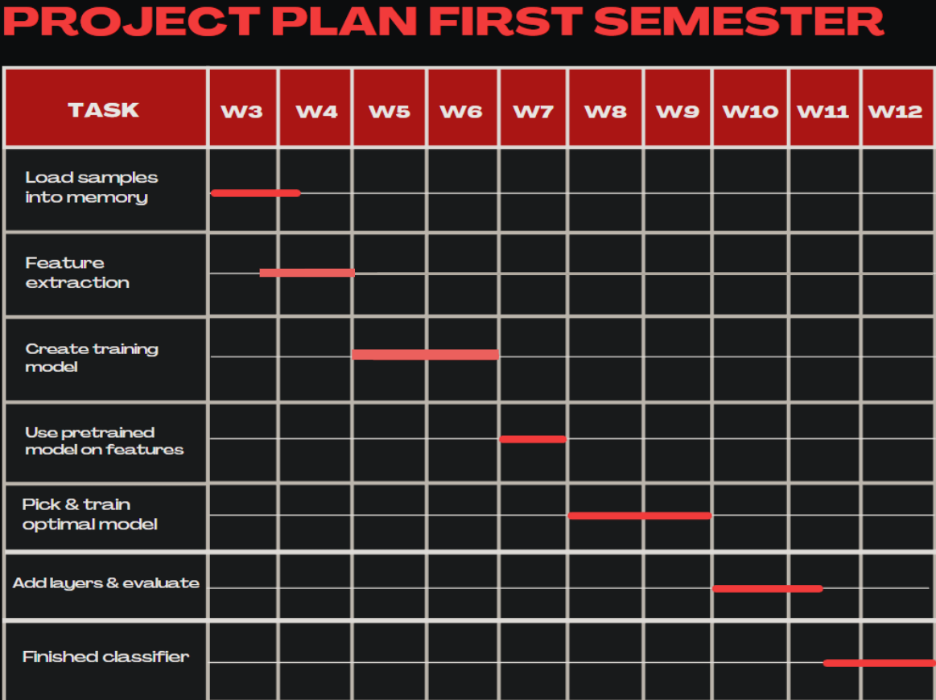
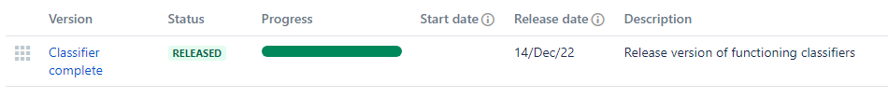
Project Planning – Classification system
Agile methodology utilized
The main focus was to develop at least one functioning classifier
This was done iteratively by completing weekly objectives
Some tasks proved challenging and required more time than initially estimated
A functioning classifier was completed by the end of the term
This was indicated by a Jira release consisting of multiple completed tasks
Fig 1. Example Jira Release
Fig 2. Gantt Chart for First Term

Slide 6
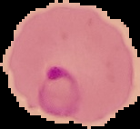

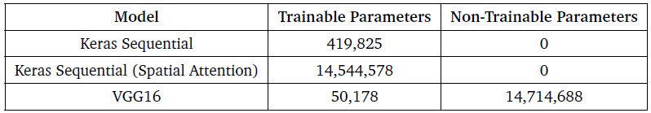


Classification
Uniquely tailored classifiers for our specific needs were created with the use of Keras & TensorFlow
These were; Keras Sequential model, Keras Sequential with Spatial Attention model, VGG16.
The architecture of each model was different (Conv2D followed by Pooling layers, Spatial Attention Mechanisms etc.)
The NIH dataset was chosen for training, validation, and testing. The dataset contains two sub-folders of parasitized and uninfected cell images. Both categories contain 13,780 images making our sample size reasonably large for the state-of-the-art classification standard.
The VGG16 model required a different pre-processing process compared to the Keras models.
Data pre-processing techniques applied to the dataset include; dimension standardization, normalization operations, and batching.
The Keras models were chosen for their heavy customizability and the VGG16 model was chosen for its wide acceptance in the field of machine learning
Fig 3. Trainable & Non-trainable Model Parameters
Fig 4. Example NIH cells

Slide 7
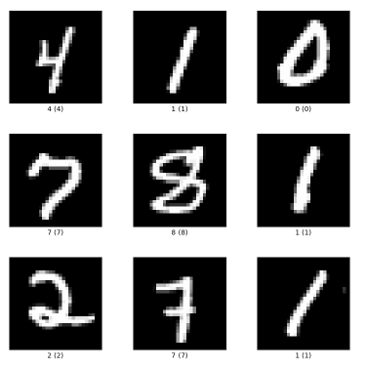
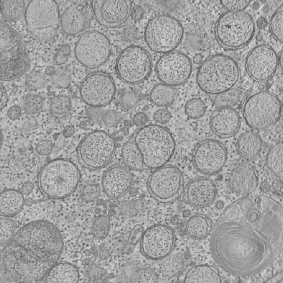
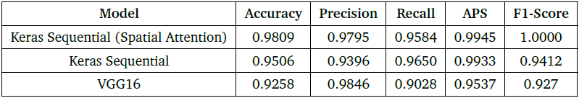
Classification
All models showed promising training performance by achieving training accuracies close to 1.
The model performance was evaluated by using evaluation metrics such as accuracy, precision, recall, average precision-score and the f1-score.
Statistical evaluation in the form of the McNemar’s test was carried out to find differences in performance.
McNemar’s test was unable to reject the null hypothesis
All models were predicted to theoretically perform very well in the end-to-end software solution.
The Keras Sequential with Spatial Attention was estimated to perform the best out of all models.
The models also looked at unknown data from project 2005 in The Cell Image Library and the MNIST dataset.
The results primarily show that the classification models are unable to distinguish data that they definitely shouldn't be predicting.
The VGG16 model had the highest accuracy on the MNIST dataset due to having pre-trained weights.
Fig 5. MNIST & P2005 Examples
Fig 6. Results of Evaluation Metrics

Slide 8
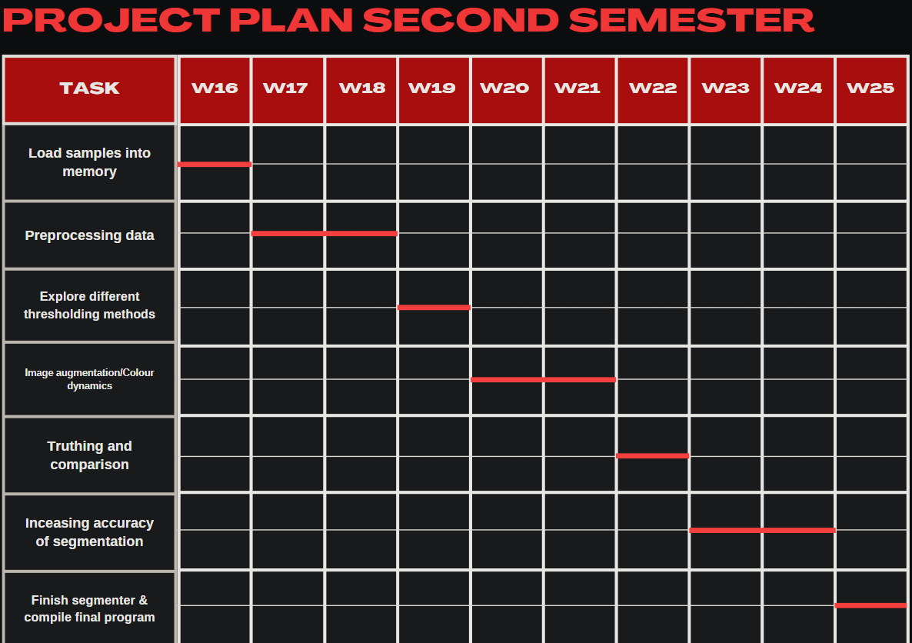
Project Planning – Segmentation & End-to-end solution
The focus of the second academic term was to create a segmentation system and combine the classification and segmentation into an end-to-end software solution.
It took a lot of experimentation to get the segmentation system to be work accurately.
I have settled for Otsu’s method and K-means clustering for thresholding.
Some tasks proposed in the Gantt Chart were skipped to save & make time for the compilation of the end-to-end system
The segmentation system & the end-to-end solution were completed successfully
Additional features were added to create a richer user experience
Fig 7. Gantt Chart for Second Term

Slide 9
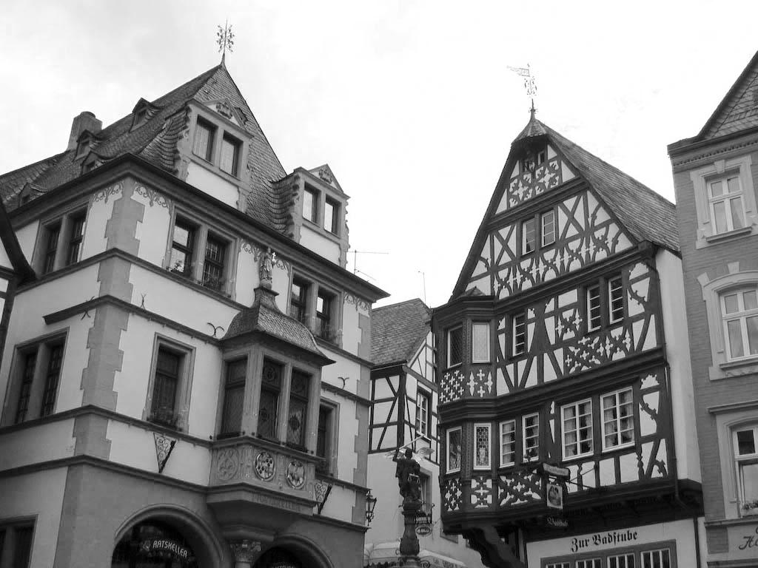
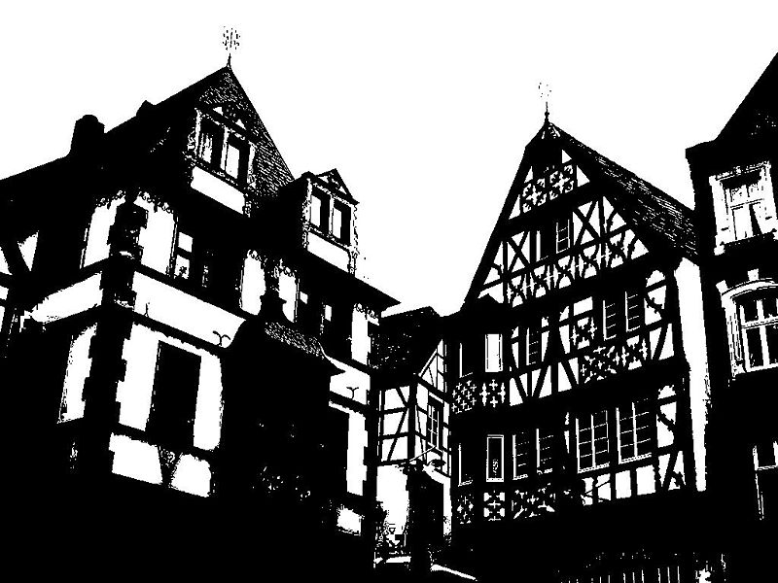


Segmentation
Otsu’s method and K-means clustering were used & implemented with the help of OpenCV
The performance of these methods was gauged with the user of the UCL dataset
UCL images were blurred using Gaussian blurring to improve performance
Images were thresholded → contoured → filtered → identified → labelled → output
These, now called ‘regions of interest’ in our context, were passed to the classifier for infection status prediction
Fig 8. Otsu’s method in action
Fig 9. K-means clustering

Slide 10
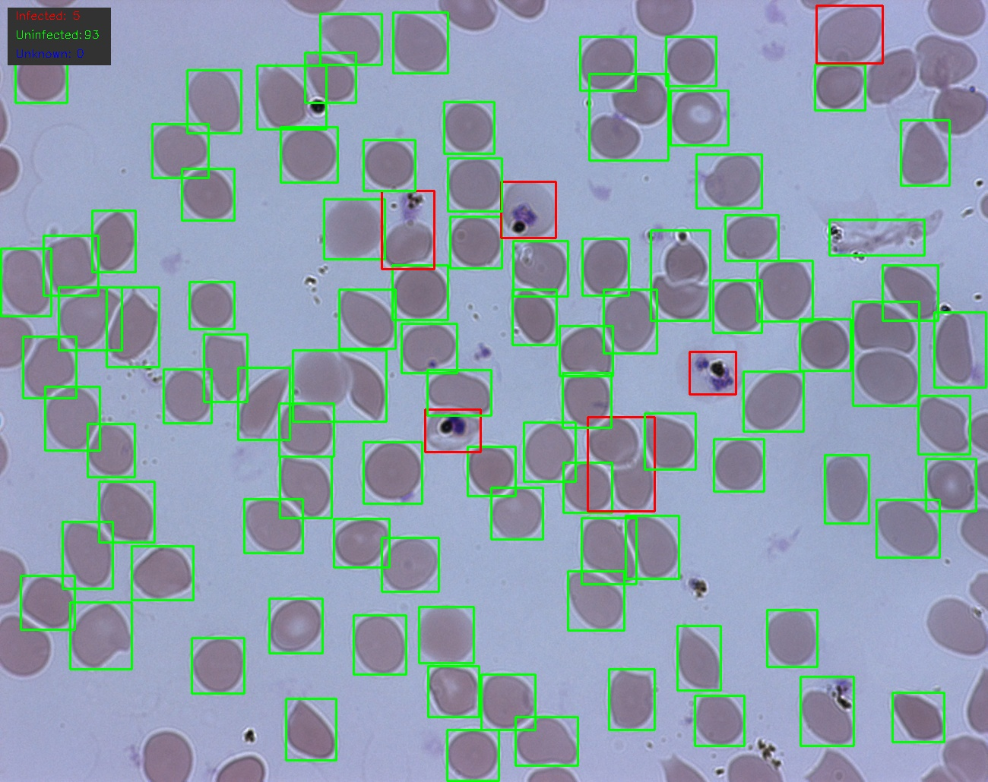
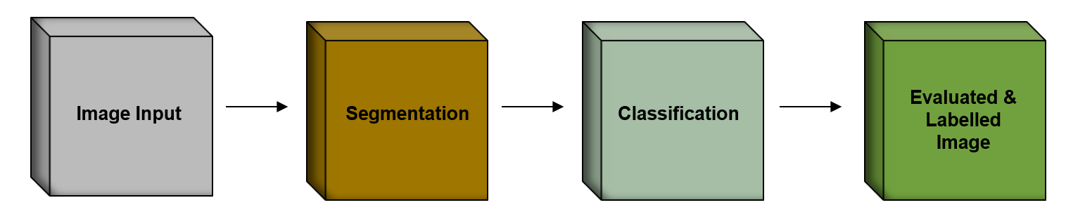
End-to-end system
Command-line operated software solution
Integrates classification and segmentation into one
Segmented images are classified by our trained models
These are then labelled and output to the user in an interactive window
Key information is provided on the image itself and in the command line output
User can; evaluate custom images or folders, save images, save image information, change output locations, change the number of clusters k-means uses
Default evaluation can be run on the UCL test dataset
System runs off of a .config file
Fig 10. End-to-end software architecture
Fig 11. Segmented and Evaluated Image

Slide 11
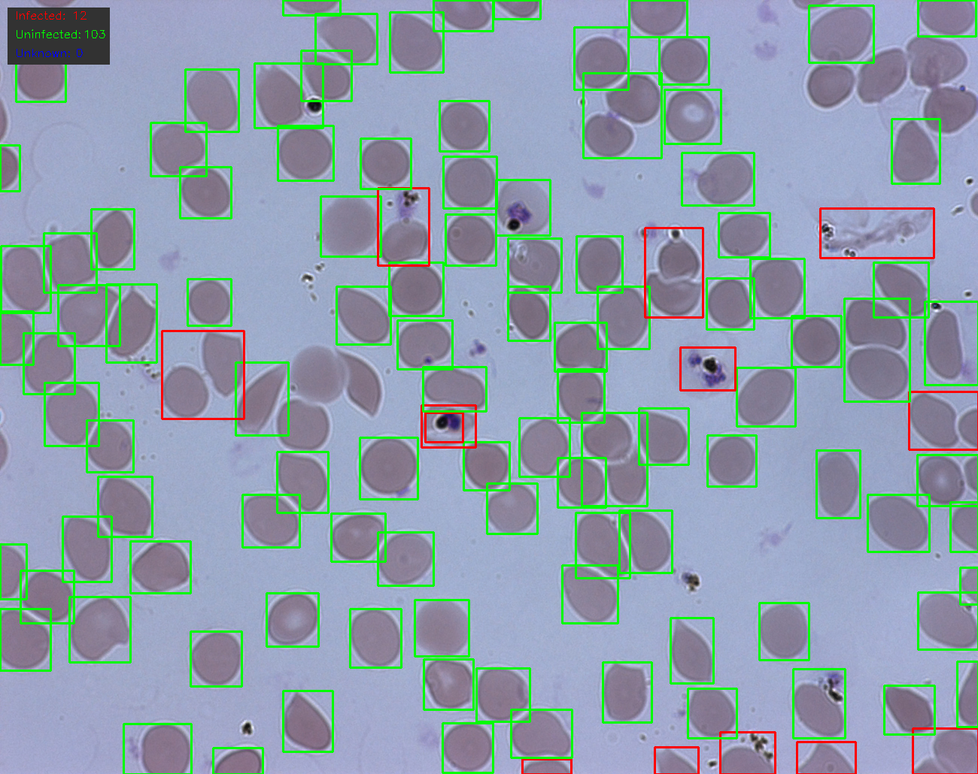
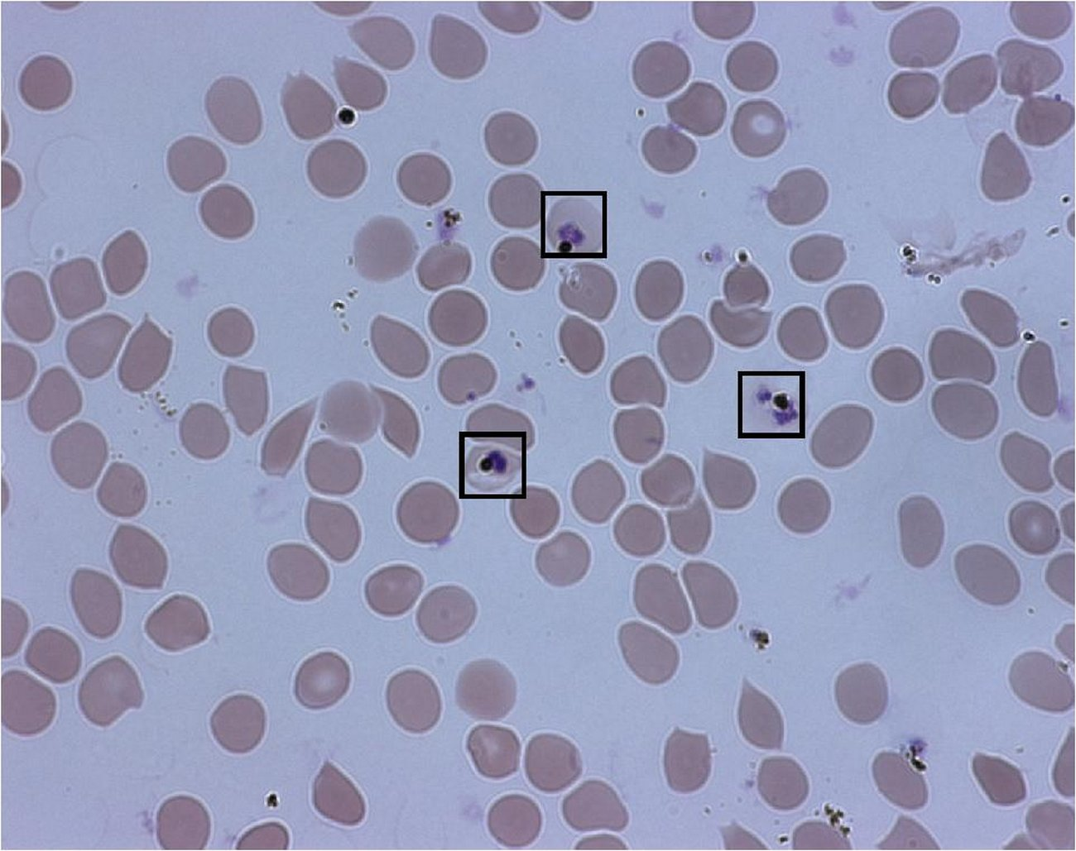
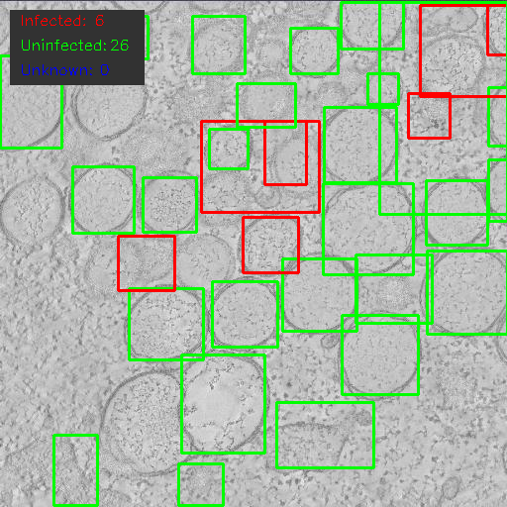
End-to-end evaluation
The main benchmark for the performance of the system was the comparison of our results to the ground truthed UCL data
We investigated the performance of each classifier and segmentation method working in tandem
We discovered that Otsu’s method performed best in combination with the Keras Sequential model
Unknown data such as the Project 2005 CIL images were evaluated
Failure modes of FPs and FNs occurred when cell-overlapping was present and light conditions weren’t ideal. Imaging artefacts were also commonly misidentified
Most combinations of classification and segmentation performed very well
Fig 12. K-means + Keras Sequential
Fig 13. Otsu’s + Keras Sequential
Fig 14. Ground truthed UCL image
Fig 15. Image 6020 from CIL evaluated

Slide 12
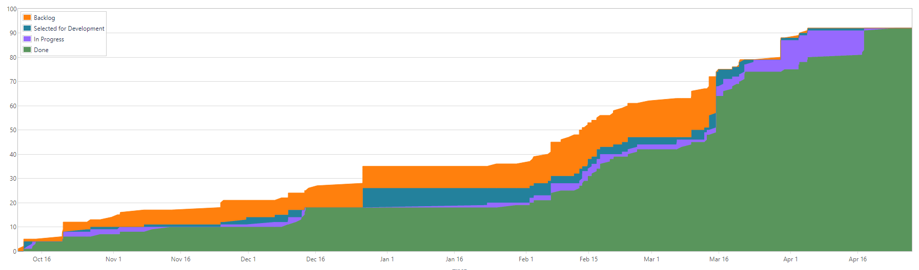
What went well…
Main goals that were set out were reached
Major developmental milestones were reached at the end of each academic term
Steady and consistent progress was achieved
Tasks were finished on a weekly basis
Current product matches the intended product closely
The end-to-end system functions efficiently with high degree of accuracy
Product is compatible, accessible, easy-to-operate and open-source
All tasks were completed →
Fig 16. Cumulative Flow Diagram

Slide 13
What went wrong…
Time management wasn’t very optimal at times
Occasionally, academic coursework stagnated development
Some tasks had to be abandoned grant priority for the development of other tasks (task files, mobile integration, GUI)
Work was done on multiple computers and occasionally results from model training was different
No major failures experienced!

Slide 14
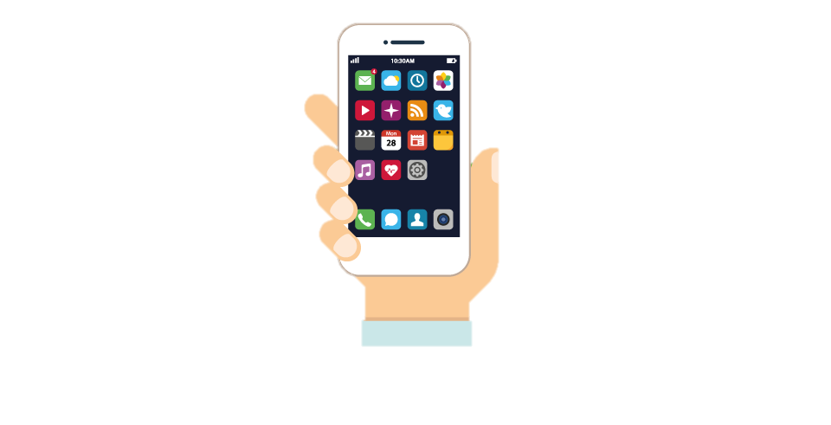
Future Work
Smart phone application can be developed to enable us to use evaluation on the go
TensorFlowLite to be integrated to reduce resource load thereby making the project more efficient
Scaling the software to improve its adaptation to large-scale data processing
Diversifying the choice of segmentation and classification models
Adapting the classification to a wider range of conditions

Slide 15
Demonstration

Slide 16
Q/A

